Slide 1
Joins in Hive
Notes:
Hi. Joins in Hive are very important for working with multiple tables and you would have come across them a lot in SQL.

Slide 2
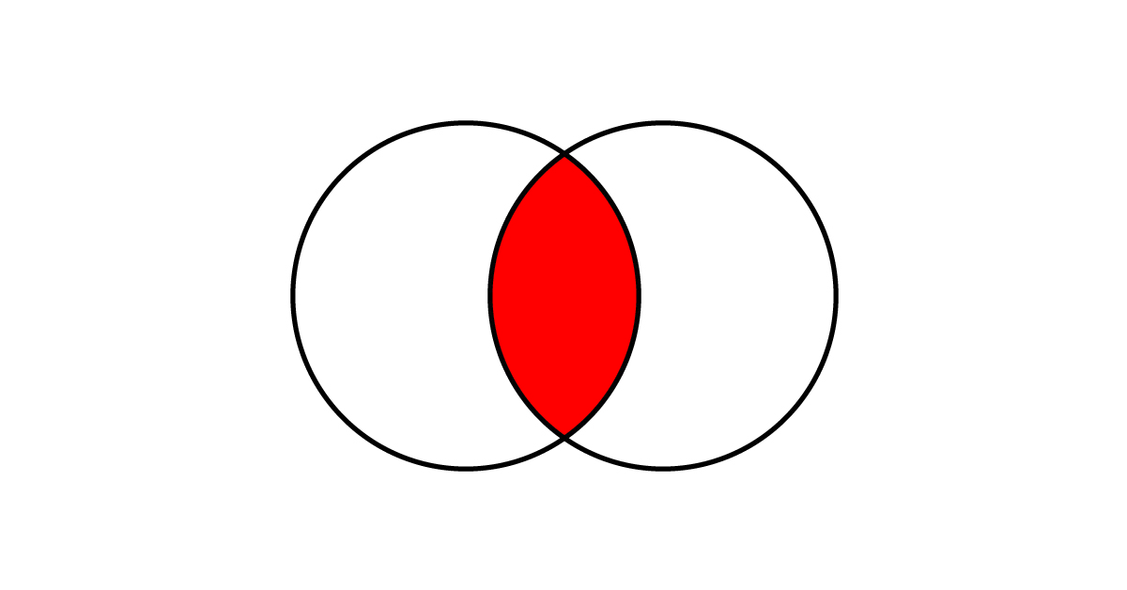
Joins in Hive
Table 1
Table 2
Notes:
For example, if we have two tables and we want to find out the common records between two tables, then joins can be very useful in that case.

Slide 3
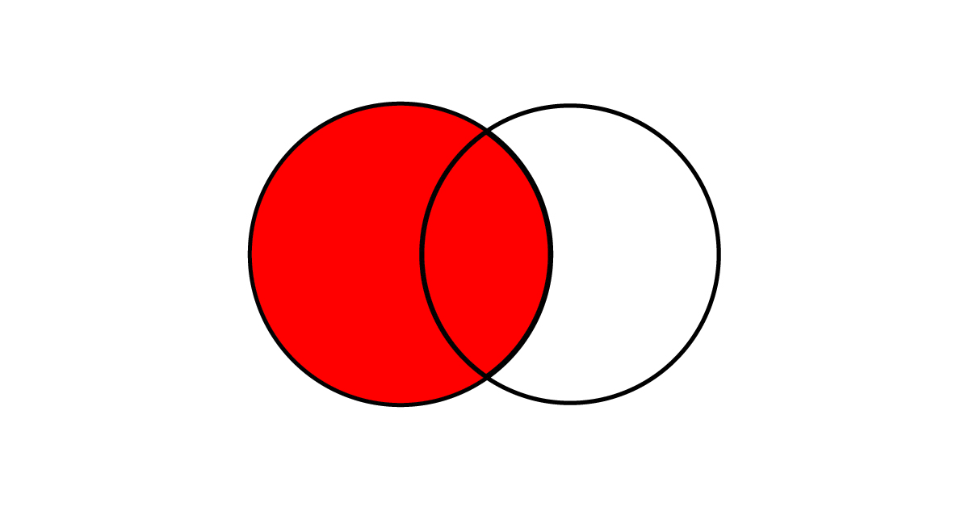
Joins in Hive
Table 1
Table 2
Notes:
Or, maybe we want all the records from one table and only matching records from the second table, then, in that case also joins can be very useful.

Slide 4
Joins in Hive
Inner Join
Left Join
Right Join
Full Outer Join
Notes:
Now, there are different types of joins in Hive, very similar to the ones you would have come across in SQL.
<<click>>
There is the inner join, left join, right join, and full outer join. Let’s take an overview of these joins.

Slide 5
Inner Join
Table 1
Table 2
INNER JOIN
Notes:
Lets talk about Inner join.
Say we have two tables, table 1 and table 2, and we want to find the common data between the two. In that case, we use the inner join.

Slide 6
Inner Join
Table 1
Table 2
A | B | C
A100 | 20 | 10
A200 | 30 | 29
A300 | 30 | 33
A | X | Y
A100 | 1 | 1
A400 | 3 | 0
A200 | 3 | 2
INNER JOIN
Notes:
Let’s take these two sample tables. We want to perform an inner join on these, to find the common data between these two.

Slide 7
Table 1
Table 2
A | B | C
A100 | 20 | 10
A200 | 30 | 29
A300 | 30 | 33
A | X | Y
A100 | 1 | 1
A400 | 3 | 0
A200 | 3 | 2
B | C
20 | 10
30 | 29
X | Y
1 | 1
3 | 2
A
A100
A200
Notes:
So first of all we need to identify the column where there will be common data in both these tables.
<<click>>
That column is column A in both the tables.
<<click>>
Now, when we perform inner join between these two tables, then…
<<click>>
Only the common records will be chosen. Here, these common records correspond to “A100” and “A200” records. Then, we will have the corresponding values for these two records from the rest of the columns in both these tables.
<<Click>>
So, we will have the values for the B and C columns from table 1, and…
<<click>>
The values for the X and Y columns from table 2.

Slide 8
Left Join
Table 1
Table 2
LEFT JOIN
LEFT OUTER JOIN
Notes:
Now let’s talk about the left join or the left outer join which includes all the records from the left table. And if there are corresponding values in the right table, then it includes that. Otherwise it keeps it as NULL values.

Slide 9
Left Join
Table 1
Table 2
A | B | C
A100 | 20 | 10
A200 | 30 | 29
A300 | 30 | 33
A | X | Y
A100 | 1 | 1
A400 | 3 | 0
A200 | 3 | 2
LEFT JOIN
Notes:
Let’s say we want to perform a left join on these two tables.

Slide 10
Table 1
Table 2
A | B | C
A100 | 20 | 10
A200 | 30 | 29
A300 | 30 | 33
A | X | Y
A100 | 1 | 1
A400 | 3 | 0
A200 | 3 | 2
A
A100
A200
A300
A
A100
A200
A300
B | C
20 | 10
30 | 29
30 | 33
X | Y
1 | 1
3 | 2
NULL | NULL
Notes:
So first of all we will join these on the column containing some common values…
<<click>>
Which is column A in this case.
<<click>>
Then we perform the left join on these two tables.
<<click>>
Here, all the records from table 1 column A will be retrieved. However, if you notice...
<<click>>
Only “A100” and “A200” are the common records between both these tables. The third record is only part of Table 1 and not Table 2. Compare this to inner join where we would have got only record “A100” and “A200”, and not the “A300” record.
<<click>>
Now, we get the columns B and C from table 1 and…
<<click>>
X and Y from table 2. However, since only two records matched in table 2, therefore here we have values for those record only. For the remaining records, that is, the third record, since there is no matching record in table 2, we will get NULL values.

Slide 11
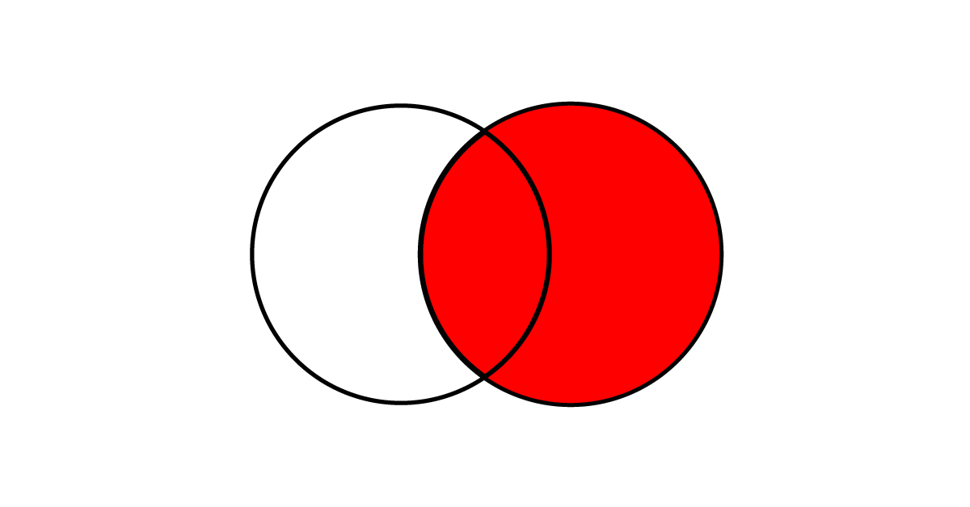
Right Join
Table 1
Table 2
RIGHT JOIN
RIGHT OUTER JOIN
Notes:
Similar to the left join, we have the right join or right outer join. Here, all the records from the right join will be present and only the matching values from the left table will be there.

Slide 12
Right Join
Table 1
Table 2
A | B | C
A100 | 20 | 10
A200 | 30 | 29
A300 | 30 | 33
A | X | Y
A100 | 1 | 1
A400 | 3 | 0
A200 | 3 | 2
RIGHT JOIN
Notes:
Let’s say we want to join these two tables.

Slide 13
Table 1
Table 2
A | B | C
A100 | 20 | 10
A200 | 30 | 29
A300 | 30 | 33
A | X | Y
A100 | 1 | 1
A400 | 3 | 0
A200 | 3 | 2
B | C
20 | 10
NULL | NULL
30 | 29
X | Y
1 | 1
3 | 0
3 | 2
A
A100
A400
A200
Notes:
So first we provide the column on which we want to join the tables
<<click>>
It is column A in this case.
<<click>>
Then we perform the right join.
<<click>>
Here, all the records from the right table or table 2 will be present here.
<<click>>
For columns B and C, values for only those records will be there for which there is a matching record in table 1. For other there will be NULL value.
<<click>>
Then we have the columns X and Y with values for all the records.

Slide 14
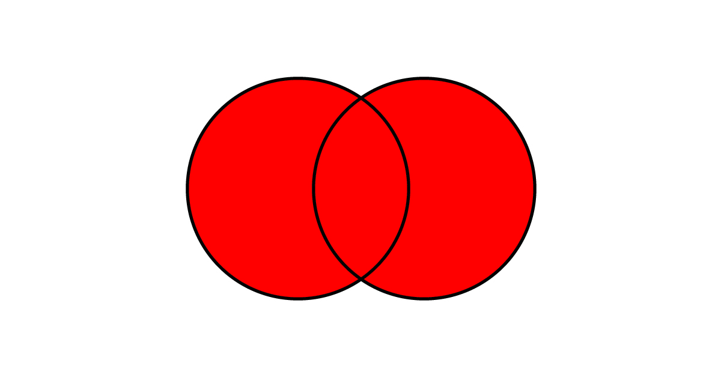
Full Outer Join
Table 1
Table 2
FULL OUTER JOIN
Notes:
So, the left join is where we are getting all the records from the left table and its matching values from the right table.
And the right join is where we are getting all the records from the right table and its matching values from the left table.
Now we have the full outer join that gets complete records from both the left and right tables together in the output.

Slide 15
Full Outer Join
Table 1
Table 2
A | B | C
A100 | 20 | 10
A200 | 30 | 29
A300 | 30 | 33
A | X | Y
A100 | 1 | 1
A400 | 3 | 0
A200 | 3 | 2
FULL OUTER JOIN
Notes:
Lets say we have these two tables and we want to perform a full outer join on these tables.

Slide 16
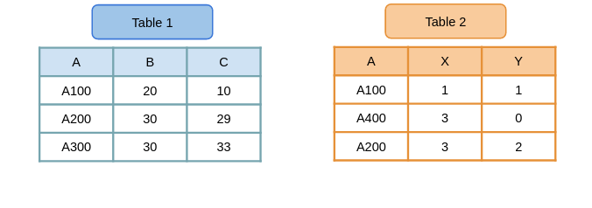
B | C
20 | 10
30 | 29
30 | 33
NULL | NULL
X | Y
1 | 1
3 | 2
NULL | NULL
3 | 0
A
A100
A200
A300
A400
Notes:
So we will be joining these two table on...
<<click>>
Column A.
<<click>>
Then the result of the full outer join will be as follows…
<<click>>
We will have all the records from table 1 and table 2. So we have record A100, A200, A300 and A400 from both these tables.
<<click>>
Then we have the values for the B and C columns. Only A100, A200 and A300 have values for B and C columns. For A400 it is going to be NULL values.
<<click>>
Then for the X and Y columns, we have values for A100, A200 and A400 records and A300 is going to have NULL values.
So if you think about it, we are getting all the unique records from column A from both the tables. This wouldn’t have been possible with just a left join or a right join. Therefore, full outer join just combines the results of these two joins.

Slide 17
Thank You!
Notes:
So that was a quick revision of joins. I hope you enjoyed it. In the next few videos we will be implementing these joins in Hive. I’ll see you there. Thank you.

